Slide 1






CFM & FMP Training Course

Slide 2


Course Introduction

Slide 3
Contents
1- Introduction to FM
2- building life cycle cost
3- CFM vs FMP vs SFP
4- FM Hero
5- Course Plan

Slide 4
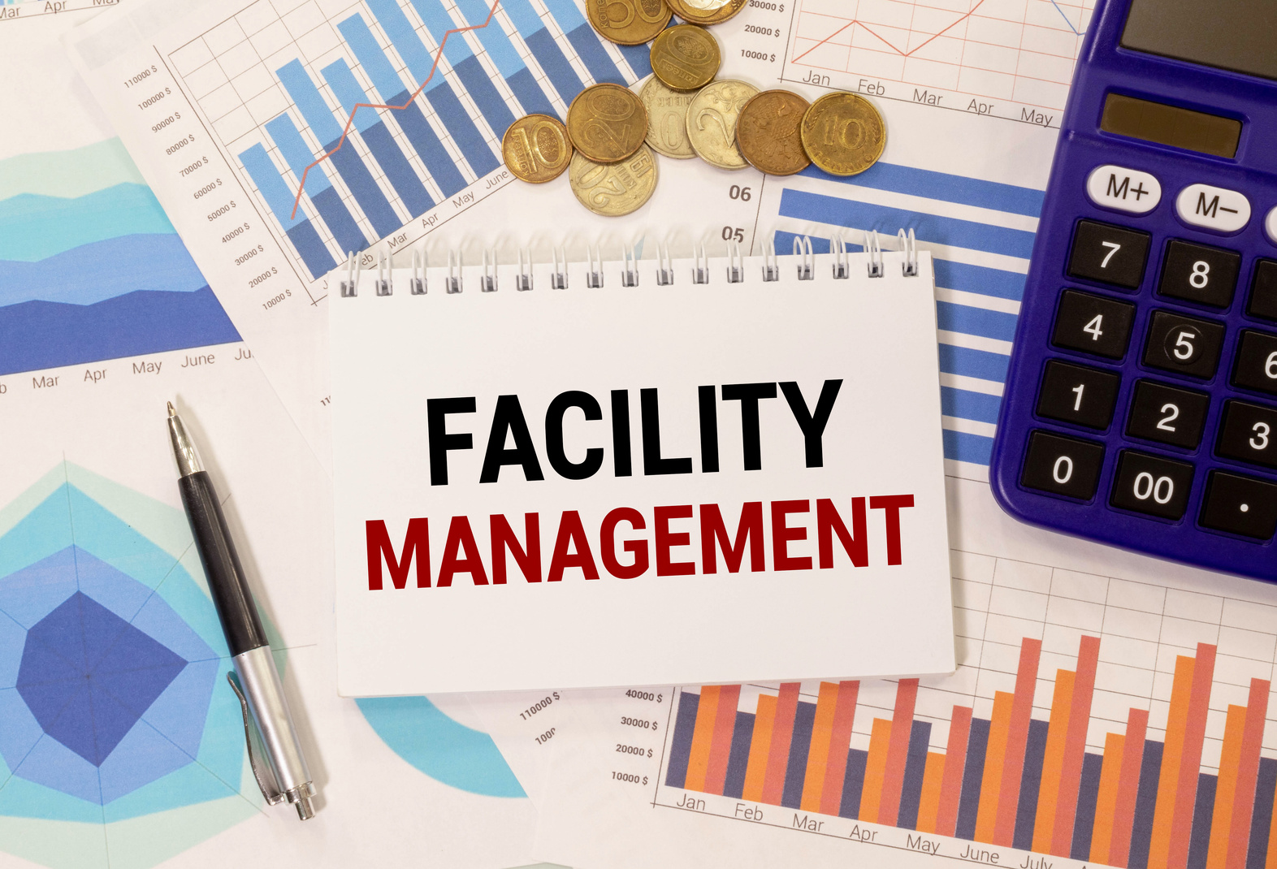
1-Introduction to FM

Slide 5

Facilites Management
VS
Operation
and
Maintenance

Slide 6
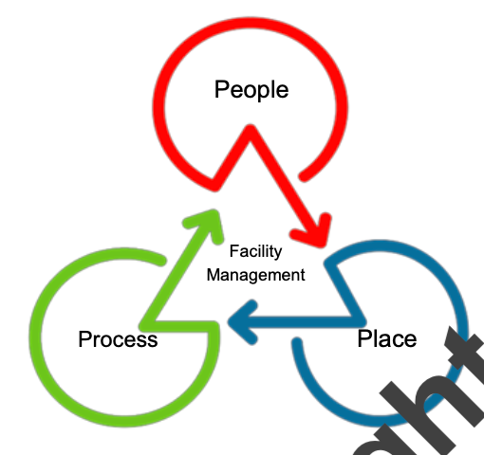
Facilities Management
Organizational function
Integrates people, place, process
Any Built environment
Enhances quality of life

Slide 7





FM Associations

Slide 8

FM History
1-Began in 1970s as operations
2- IFMA founded in 1980 USA
3-IWFM founded 1993 in UK
4-Global FM launched in 2006
5-ISO 41001 released in 2018

Slide 9

3-Facility
Life Cycle Cost

Slide 10

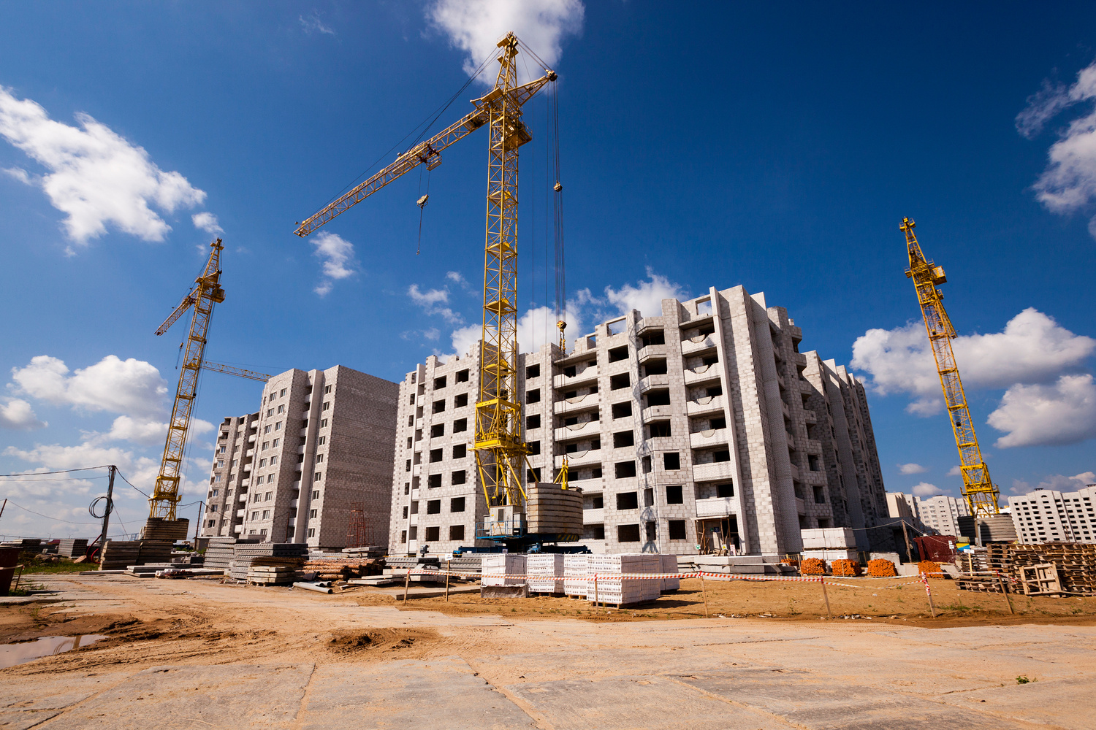
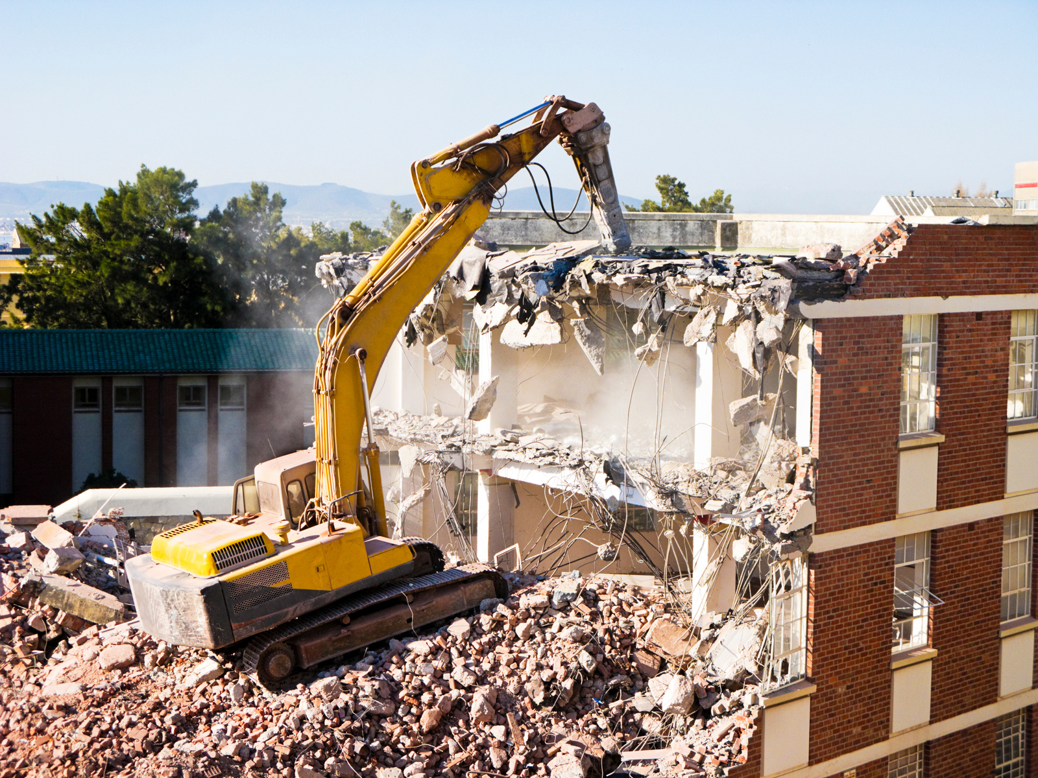
Total Cost of Ownership
Design
construction
Facility Management
Disposal

Slide 11
Design Phase
1 - 2 Years
6% to 7%

Slide 12
Construction
1 - 5 Years
20% to 40%

Slide 13
Facility Management
50 - 80 Years
60% to 80%

Slide 14
Disposal
0 - 1 Year
3% to 4%

Slide 15
Total Cost of Ownership
6% to 7%
20% to 40%
60% to 80%
6% to 7%
Design
construction
Facility Management
Disposal
1 - 2 Years
1 - 5 Years
50 - 80 Years
1- 2 Year

Slide 16
Total Cost of Ownership
6% to 7%
20% to 40%
60% to 80%
6% to 7%
Design
construction
Facility Management
Disposal
1 - 2 Years
1 - 5 Years
50 - 80 Years
1- 2 Year
FM

Slide 17

3- CFM vs FMP vs SFP

Slide 18
Facility Management Professional
1- Operation & Maintenance
2- Leadership and Strategy
3- Fainance and Business
4- Project Management

Slide 19
4 Exams Mutible Choice
Online Exam without Camera

Slide 20

Sustainability Facility Professional
3 Units & 12 Chapters
12 Exams Mutible Choice
Online Exam without Camera

Slide 21
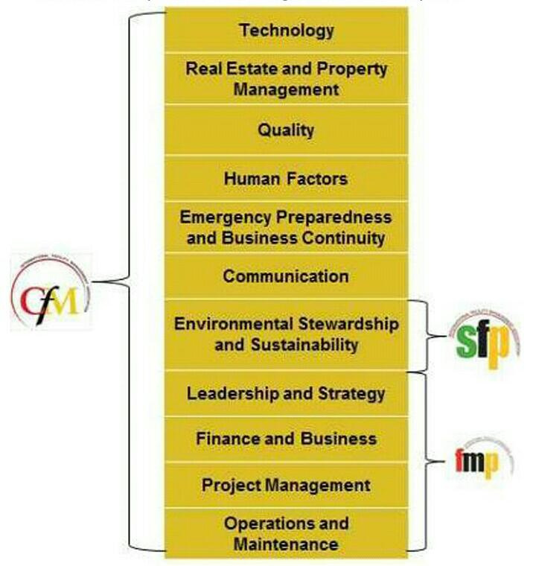

Slide 22
Certified Facility Manager
Exam on Center Not Onile
Multiple Choice 180 Questions
11 competencies in one Exam

Slide 23
New Exam Questions
1- Every Question, 3 Choices
2- 60% to 70% Scenario Questions
3- 180 Questions in 4 Hours
Before August 31, 2025

Slide 24
New Exam Questions
1- Every Question, 3 Choices
2- 60% to 70% Scenario Questions
3- 120 Questions in 3 Hours
After September 1, 2025

Slide 25
Eligibility Requirements
Option 1: No Bsc or Master in FM
5 Yrs on Facilities Management
Experience ( 6 competencies)
Any university education

Slide 26
Eligibility Requirements
Option 2: Bsc or Master in FM
3 Yrs on Facilities Management
Experience ( 6 competencies)
Any university education

Slide 27




IFMA Exams Fees

Slide 28
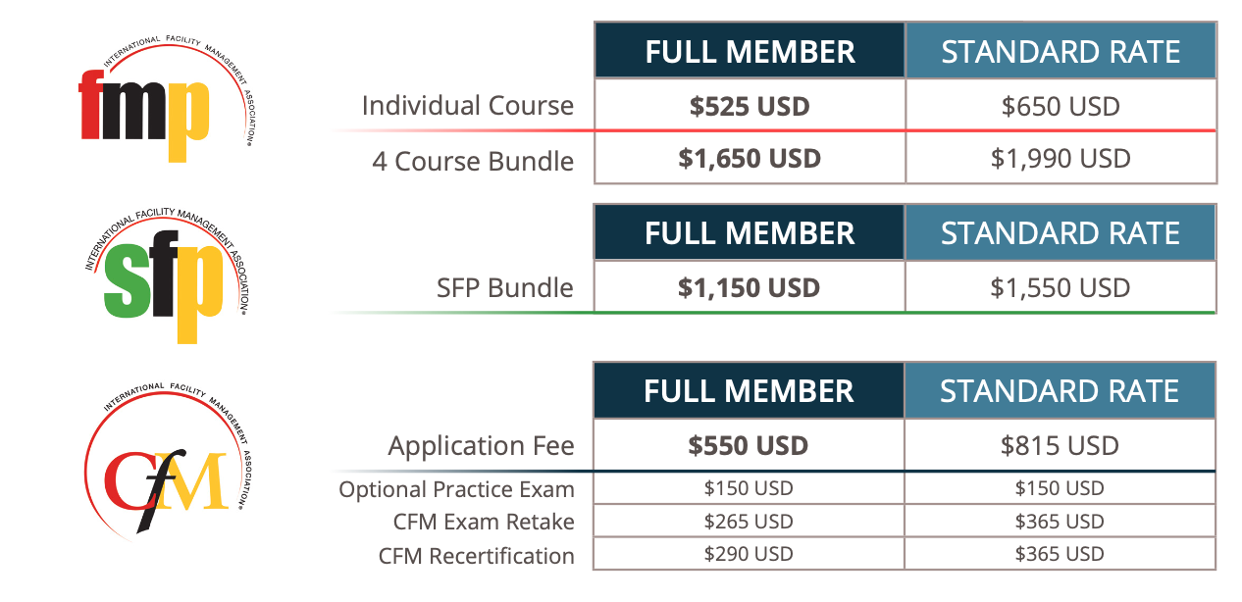

Slide 29

4- FM Hero

Slide 30

Kahoot Instructions

Slide 31

Kahoot Instructions
Exercises can be solved from the computer via browsers through the website.
https://kahoot.com/

Slide 32
Kahoot Instructions
Or form Kahoot App on Smart Phone
Android ot Apple
https://kahoot.com/

Slide 33
Kahoot Instructions
When you start solving the exercise, you can register your real name or a pseudonym

Slide 34
Kahoot Instructions
There are two types of exercises (multiple choice and true or false), and the multiple choice may have one answer or more than one answer.

Slide 35
Kahoot Instructions
Each question has a duration and points that appear at the bottom, and the points decrease over time

Slide 36
Kahoot Instructions
Your points are determined by two things: the correctness of your answer and your speed in answering

Slide 37
Kahoot Instructions
When you finish solving the entire exercise, the number of points you have earned and your final ranking among those who have completed the exercise will appear.

Slide 38
Kahoot Instructions
You can solve questions in which your answer was incorrect without points
(this feature is only available when entering through App Androide and Apple )

Slide 39


Download Kahoot App
Androide
IOS

Slide 40
Facility Manager Hero

Slide 41

FM Hero Vedio

Slide 43
FM Hero Questions
PIN:
444444444

Slide 44

5- Course Plan

Slide 45
Day | Day | Sessions | Course | Duration
1 | Saturday | Introductions + Operation and Maintenance | CFM & FMP | 3 Hours
2 | Sunday | Leadership and Strategy | CFM & FMP | 3 Hours
3 | Monday | Finance and Business | CFM & FMP | 3 Hours
4 | Tuesday | Project Management + FMP Plan | CFM & FMP | 3 Hours

Slide 46
Day | Day | Sessions | Course | Duration
5 | Wednesday | Quality and Performance | CFM | 3 Hours
6 | Saturday | Sustainability | CFM | 3 Hours
7 | Sunday | Human Factor + ½ Risk Management | CFM | 3 Hours
8 | Monday | ½ Risk Management + Real Estate | CFM | 3 Hours
9 | Tuesday | Technology and Information | CFM | 3 Hours
10 | Wednesday | CFM Study Plan | CFM | 3 Hours

Slide 47

THANK YOU

